Slide 1
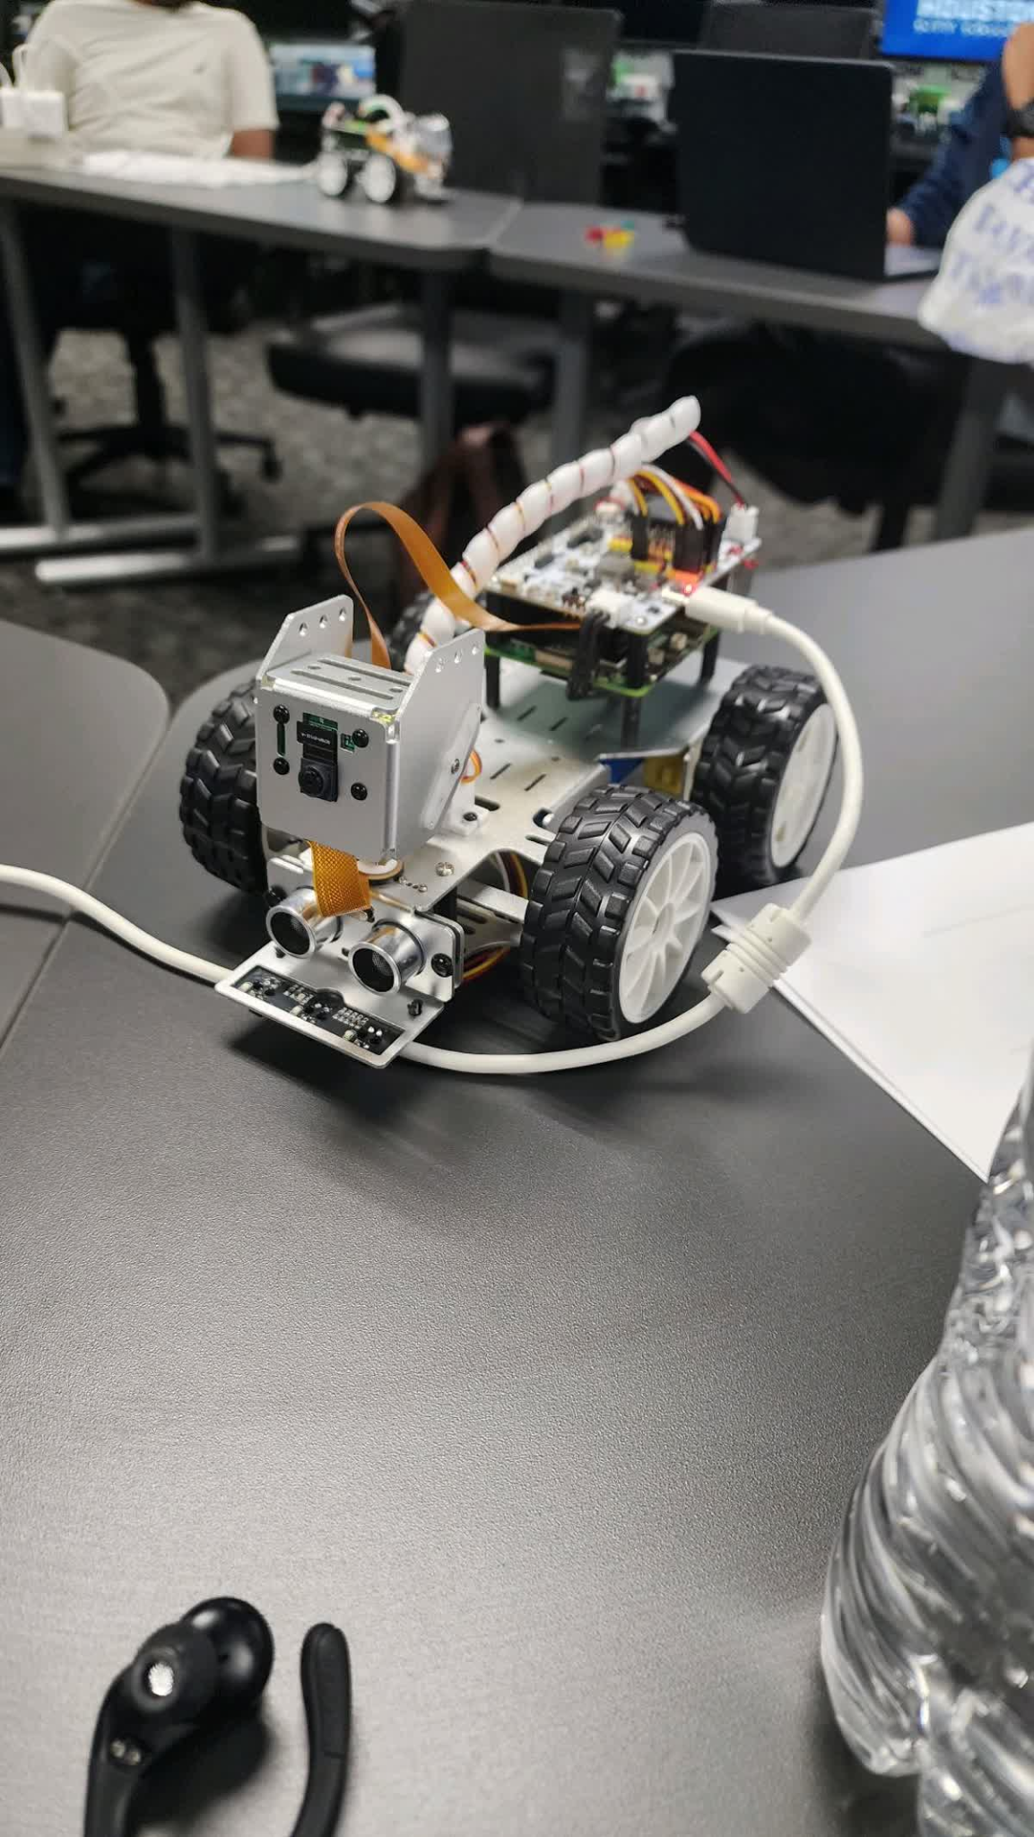
RaspberryPiCar5
Francisco Medina

Slide 2
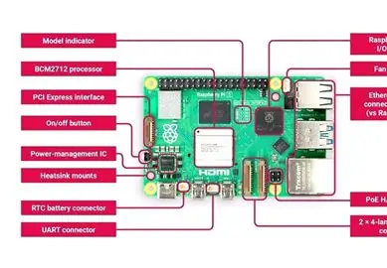
RaspberryPi5_ Hardware
A closer look at the design, components, and performance
By- Francisco Medina & Michael Garcia
6261-14325-ITAI-2374
Sitaram Ayyagari

Slide 3
What is Raspberry Pi 5?
Released by the Raspberry Pi Foundation in October 2023.
Represents a major upgrade over the Pi 4 in speed, features, and connectivity.
Main purpose: low-cost, high-performance computing for learning, IoT, robotics, and DIY projects.

Slide 4
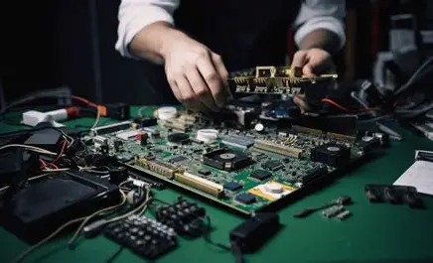
Core Specifications
Processor (CPU): Broadcom BCM2712 – quad-core ARM Cortex-A76 @ 2.4 GHz
Graphics (GPU): VideoCore VII @ 800 MHz
Memory: 4 GB / 8 GB LPDDR4X RAM
Storage: microSD slot + PCIe 2.0 interface for SSD expansion
Power: USB-C (5 V / 5 A)

Slide 5
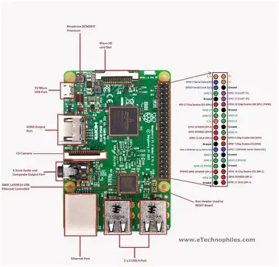
Board Layout and Components
CPU & GPU integrated on main SoC
RAM chip mounted on top of the SoC (PoP design)
Dual micro-HDMI 2.0 ports (4K @ 60 Hz)
Dual USB 3.0 + Dual USB 2.0 ports
Gigabit Ethernet port (with PoE+ support)
40-pin GPIO header for sensors & extensions
Camera and display connectors (CSI/DSI)

Slide 6

Performance Improvements
Up to 2–3× faster CPU performance than Pi 4
New GPU supports OpenGL ES 3.1 and 4K video output
PCIe 2.0 lane enables NVMe SSD support
Dedicated power management IC for better stability
Lower idle power draw and improved thermal control

Slide 7

Connectivity Features
Wi-Fi 6 (802.11ax) + Bluetooth 5.0
Gigabit Ethernet for wired networking
Improved USB bandwidth (10 Gbps total)
Support for multiple cameras and displays

Slide 8
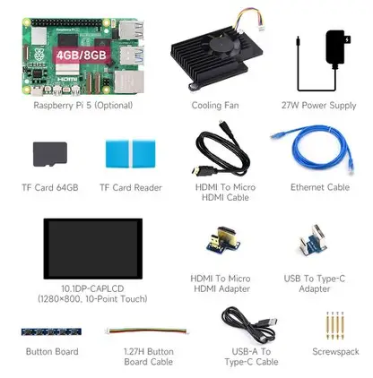
Expansion and Accessories
HATs (Hardware Attached on Top) remain compatible
NVMe HAT+ accessory for SSDs
Active Cooler or Official Case with Fan recommended
Works with official 27 W USB-C power supply

Slide 9
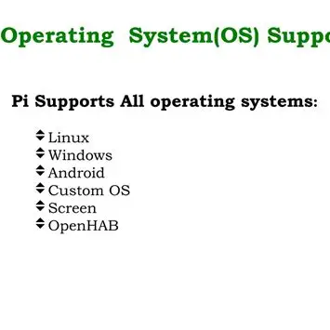
Operating System Support
Primary OS: Raspberry Pi OS (Bookworm), based on Debian 12.
Kernel: Linux 6.1 optimized for the BCM2712 chip.
64-bit architecture by default (no more 32-bit limitation).
Supports other Linux distributions:
Ubuntu Server / Desktop for Pi 5
Manjaro ARM, DietPi, Kali Linux, LibreELEC, etc.
Boot options: microSD card, NVMe SSD (via PCIe), or USB.

Slide 10
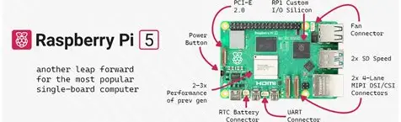
Software Features & Performance
New Raspberry Pi OS desktop with Wayland-based display server.
Updated VideoCore VII GPU drivers for smoother 3D and 4K video.
Improved bootloader and firmware for faster startup.
Includes development tools:
Python 3, Thonny IDE, C/C++ SDK
GPIO libraries: RPi.GPIO, gpiozero
Fully compatible with VS Code and Remote SSH development.

Slide 11
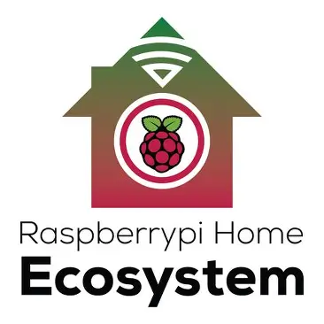
Software Ecosystem
Pi Apps store for quick installation of tools.
Camera & Media Stack: new libcamera system for HD video capture.
Network & IoT software: Mosquitto (MQTT), Node-RED, Home Assistant.
AI & ML support: TensorFlow Lite, OpenCV, PyTorch ARM builds.
Education tools: Scratch, Sonic Pi, and Minecraft Pi Edition.

Slide 12
Comparison with Raspberry Pi 4
Feature: Pi 4 Pi 5
CPU: Cortex-A72 @ 1.5 GHz Cortex-A76 @ 2.4 GHz
GPU: VideoCore VI VideoCore VII
RAM: up to 8 GB LPDDR4 4 / 8 GB LPDDR4X
Power: USB-C (5 V / 3 A) USB-C (5 V / 5 A)
Storage: microSD only microSD + PCIe SSD

Slide 13
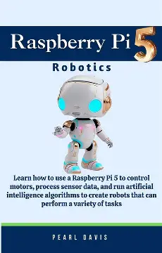
Use Cases & Applications
Robotics and IoT controllers
Retro gaming consoles
Home servers or NAS with SSD
AI and machine learning experiments
DIY electronics and coding education

Slide 14
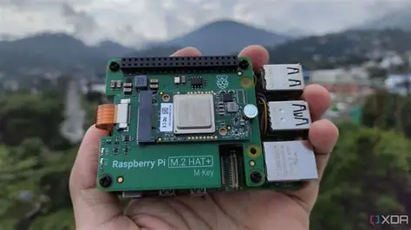
In conclusion
Raspberry Pi 5 combines stronger hardware with modern software.
Offers a true desktop-class Linux experience.
Suitable for both education and professional prototyping.

Slide 15
References.
Raspberry Pi Foundation. Raspberry Pi 5 Product Page. https://www.raspberrypi.com/products/raspberry-pi-5/
Raspberry Pi Documentation: Raspberry Pi 5 Hardware Guide. https://www.raspberrypi.com/documentation/computers/raspberry-pi-5.html
Reviews: Tom’s Hardware, The Verge, Raspberry Pi News.
https://www.raspberrypi.com/software/

Slide 16

Robot HAT

Slide 17
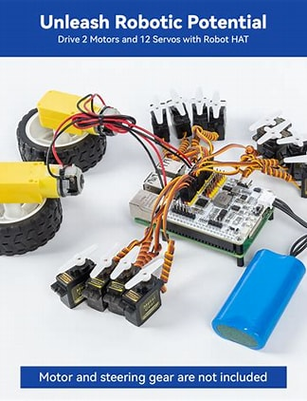
What is Robot HAT?
It’s A Robot HAT (Hardware Attached on Top) is an expansion board designed to control motors, servos, and sensors through the Raspberry Pi’s GPIO pins.
The purpose is to simplify robotics development by providing dedicated motor drivers, servo control, and power management.
It works with with Raspberry Pi 5, 4, and 3 via the 40-pin GPIO header.
Typical Used for small autonomous robots, robotic arms, or smart-vehicle projects

Slide 18
Hardware Features of the Robot HAT
Motor Drivers: Dual DC motor ports and stepper-motor control via PWM.
Servo Ports: Typically 4–8 PWM channels for hobby servos.
Sensor Interfaces: I²C, SPI, and UART ports for distance, line, or motion sensors.
Power System: Built-in battery management and 5 V regulator for the Pi.
Other Features: Onboard buzzer, infrared receiver, and programmable LED indicators.

Slide 19
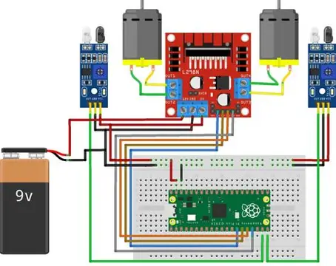
How the Robot HAT Works with Raspberry Pi 5
Connects directly to the Pi’s 40-pin GPIO header — no additional wiring needed.
The Pi 5 runs control scripts (Python 3 or C++) that send PWM and I²C commands through GPIO.
The Robot HAT’s microcontroller or driver IC translates these signals into motor/servo movements.
Libraries like picar-x, adafruit-motorHAT, or gpiozero simplify programming.
Real-time control is handled by the Pi CPU; low-level power regulation and safety handled by the HAT.

Slide 20
Programming & Applications
Software Support: Python libraries such as picar-x, RPi.GPIO, gpiozero, and PCA9685.
Typical Projects:
Line-following robot
Obstacle-avoidance car
Robotic arm controller
Smart sensor platform
Integration Example:
Ultrasonic sensor via I²C for distance measurement
Servo motor for steering control
Pi Camera for computer vi

Slide 21
Advantages of Using Robot HAT with Pi 5
Eliminates the need for a separate microcontroller (Arduino or ESP32).
Provides stable power to motors and the Pi from a single battery source.
Compact and stackable design for robot chassis.
Supports multiple sensor types — great for STEM and AI learning.
Fully compatible with Raspberry Pi OS and Python.

Slide 22
References
“Robot Hat v4.” Sunfounder, www.sunfounder.com/projects/robot-hat-v4/en/latest/robot_hat_v4.html. Accessed 13 Oct. 2025.
Raspberry Pi Documentation – https://www.raspberrypi.com/documentation/
Waveshare Robot HAT Product Page – https://www.waveshare.com/wiki/Robot_HAT
SunFounder PiCar X Kit – https://www.sunfounder.com/

